Slide 1
Teamwork Makes the Dream WORK
Vickie Vinson
ABE Coordinator

Slide 2
ABE Academy at CVCC
ABE Academy was created in 2016 as a result of the introduction of WIOA and the 13 considerations
Concept was to create a daily program for IDD individuals to introduce them to employment possibilities and career options while continuing basic education instruction – contextualization!

Slide 3
In the beginning……
ABE Academy hours were 9:00 AM – 2:00 PM Monday through Thursday
Attendance policy was created and enforced
A syllabus was created based on the Career Cluster Guide.
Instructors planned contextualized lessons based on the weekly career theme
This Photo by Unknown Author is licensed under CC BY-SA-NC

Slide 4
Additional Aspects…
Program is a minimum two-year program
Students can qualify to return for a third year and possibly a fourth year.
Four years is maximum enrollment.
Students are placed in groups based on reading assessment scores. (CASAS Reading Goals)
This Photo by Unknown Author is licensed under CC BY

Slide 5
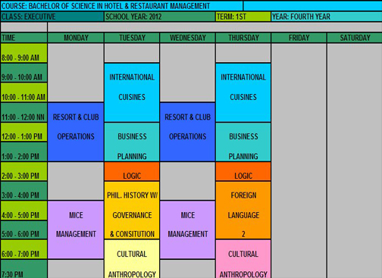
2017
Employ-ABILITY “Pathway” was created.
Employ-ABILITY is a collaborative effort between CCR, HRD, and Workforce Development
Classes meet Wednesday and Thursday morning from 9:00 AM – 12:00 PM
Students continue to attend the ABE Academy on Monday and Tuesday, as well as 12:00 PM - 2:00 PM on Wednesday and Thursday.
This Photo by Unknown Author is licensed under CC BY-NC-ND

Slide 6
Enrollment Criteria for Co-hort
Co-hort of 7-10 students beginning the fall semester of each year.
Minimum NRS Level 2
No behavior issues
No attendance issues
Instructor and coordinator recommendation
This Photo by Unknown Author is licensed under CC BY-NC

Slide 7
Co-hort Classes
CORE CLASSES
Working Smart
Computer Literacy
Digital Literacy
Career & Employability Skills
Classes are waivered per HRD directives
Classes are taught by HRD staff
This Photo by Unknown Author is licensed under CC BY-NC-ND

Slide 8
Following Core Classes
Students are given the opportunity to enroll in one of many occupational extension classes offered. Examples are below:
Basic Food Service
Food and Beverage Operations
Travel and Tourism
Inventory Control
Custodial Basics
Sales and Marketing
Front Desk Assistant
Customer Service
Carpentry Basics
Horticulture Basics
Auto Detailing
This Photo by Unknown Author is licensed under CC BY

Slide 9
May, 2022 – IDD Implementation Team Created
The initial Implementation Team consisted of nine team members. Representatives from the following departments attended the initial meeting:
College and Career Readiness
Human Resources Development
Senior Leadership
Business Office
Disability Services
Student Services

Slide 10
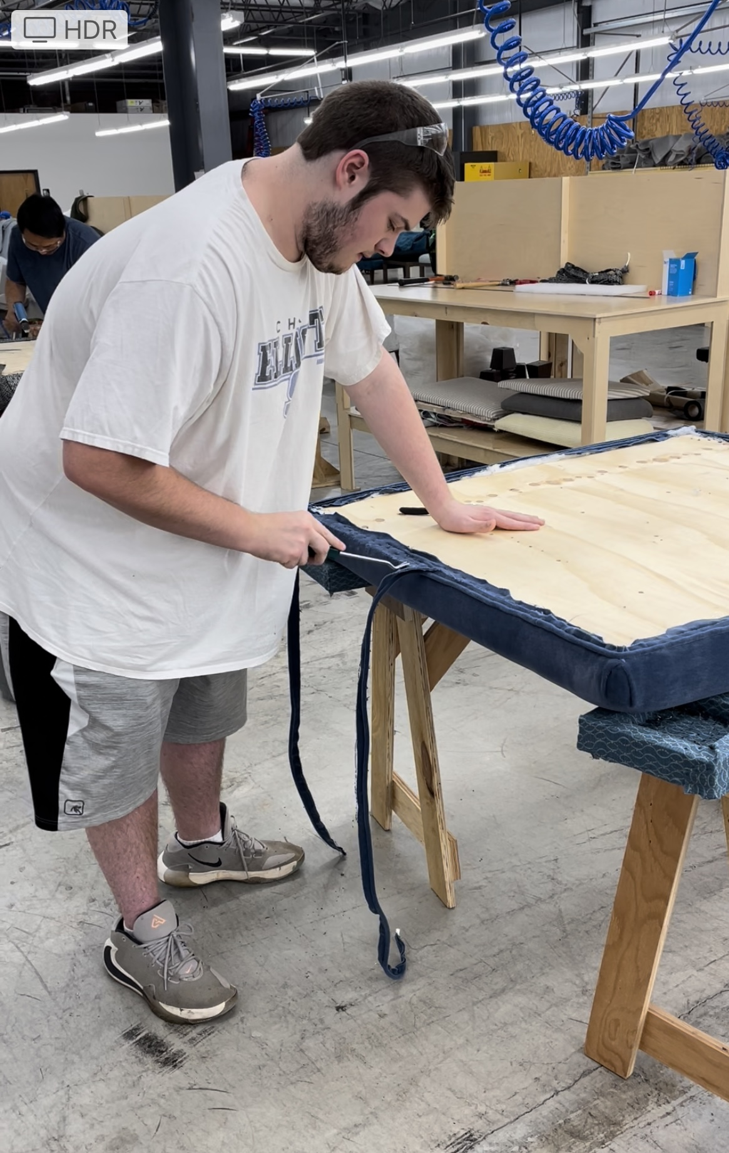
Also in May, 2022…
Carpentry Basics students successfully completed CPR and First Aid Certification.
One of our ABE Academy students enrolled in the CVCC Furniture Academy. He is scheduled to graduate
from Furniture Academy
this May and already has
multiple job offers.

Slide 11
Implementation Team Grows
The implementation team continued to meet throughout the summer of 2022.
By the fall of 2022, the implementation team had expanded from 9 team members to 15 team members.
Team now includes representatives from Workforce Connectivity and Catawba Apprenticeship Network, Minority Community Outreach, Office of Diversity and Community Engagement, Economic Development and Corporate Education

Slide 12
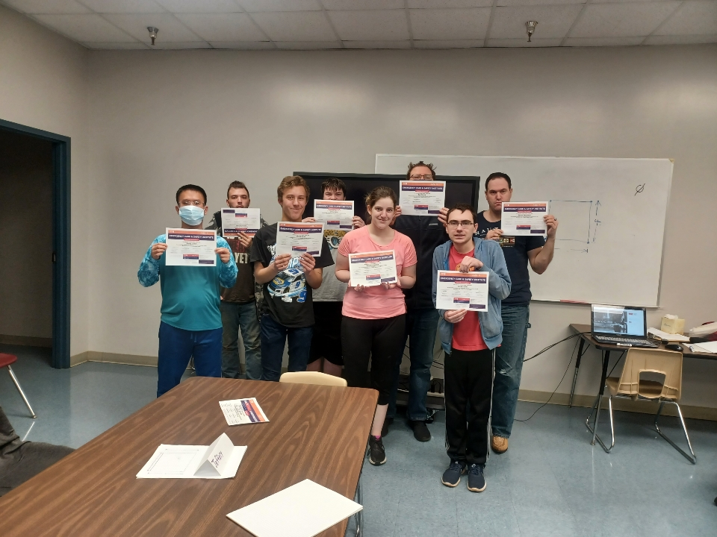
Expanded Team = Expanded Opportunities
Fall, 2022 – Students who had completed the Employ-ABILITY core classes had the opportunity to enroll in Manufacturing Basics where they obtained OSHA-10 certification, First Aid/CPR certification, and LEAN mfg.

Slide 13
Fall, 2022 (continued)
Curriculum Involvement: Students had the opportunity to enroll in Early Childhood Education Basics. Students attended class once weekly. Class was taught by Early Childhood curriculum instructors. Students applied for and received their qualifying letter from the state at the end of the semester. The qualifying letter states that the student is approved to begin working in childcare in NC.
This Photo by Unknown Author is licensed under CC BY-SA-NC

Slide 14
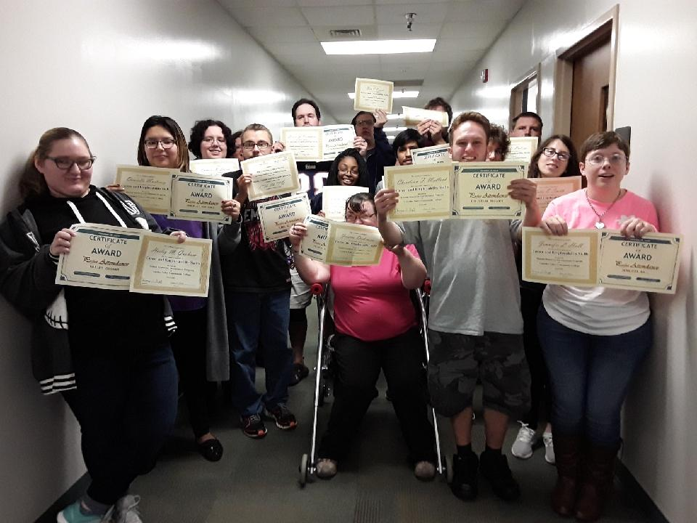
Fall 2022
7 ABE Academy students began the Employ-ABILITY core classes, beginning with Working Smart. This group of students was the 6th co-hort to begin the pathway since Spring, 2017.

Slide 15
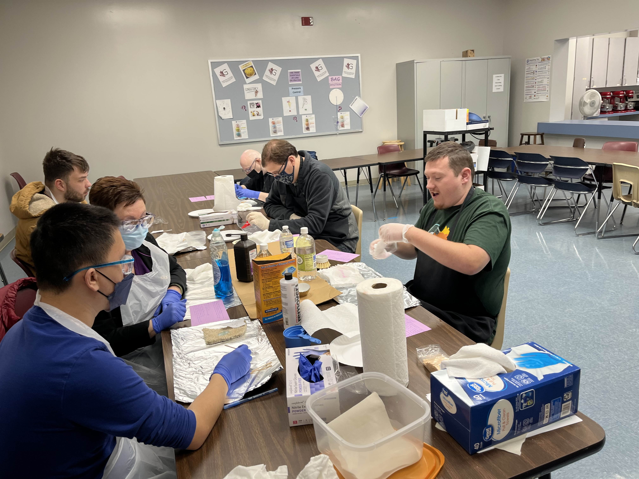
Spring, 2023
Employ-ABILITY co-hort continues
5 students are enrolled in Custodial Technician Basics. Students will be prepared to take the Cleaning Management Institute’s Certified Custodial Technician certification at the end of the class.

Slide 16
Spring, 2023
Supreme Maintenance Organization has joined the Catawba Apprenticeship Network to offer paid apprenticeship opportunities to students in the Custodial Technician Basics class.
A pre-apprenticeship has been approved for any student who completes the four core Employ-ABILITY classes.

Slide 17
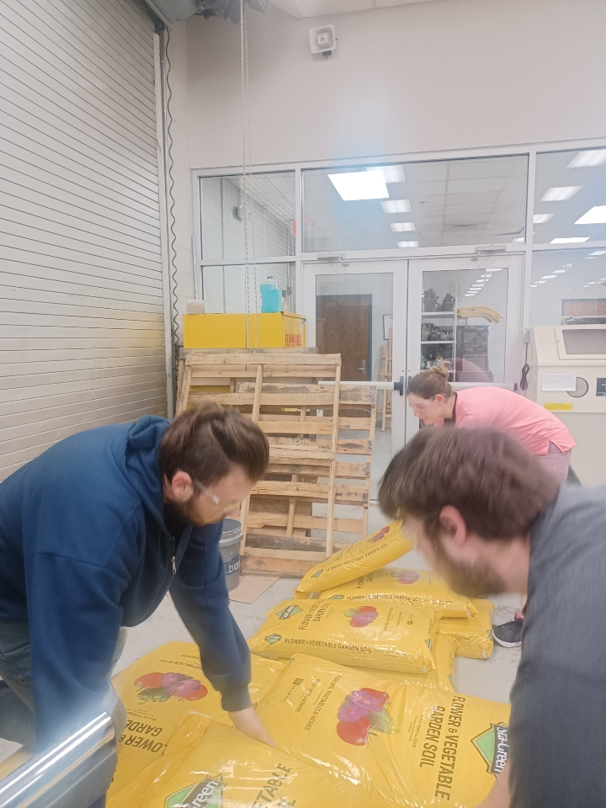
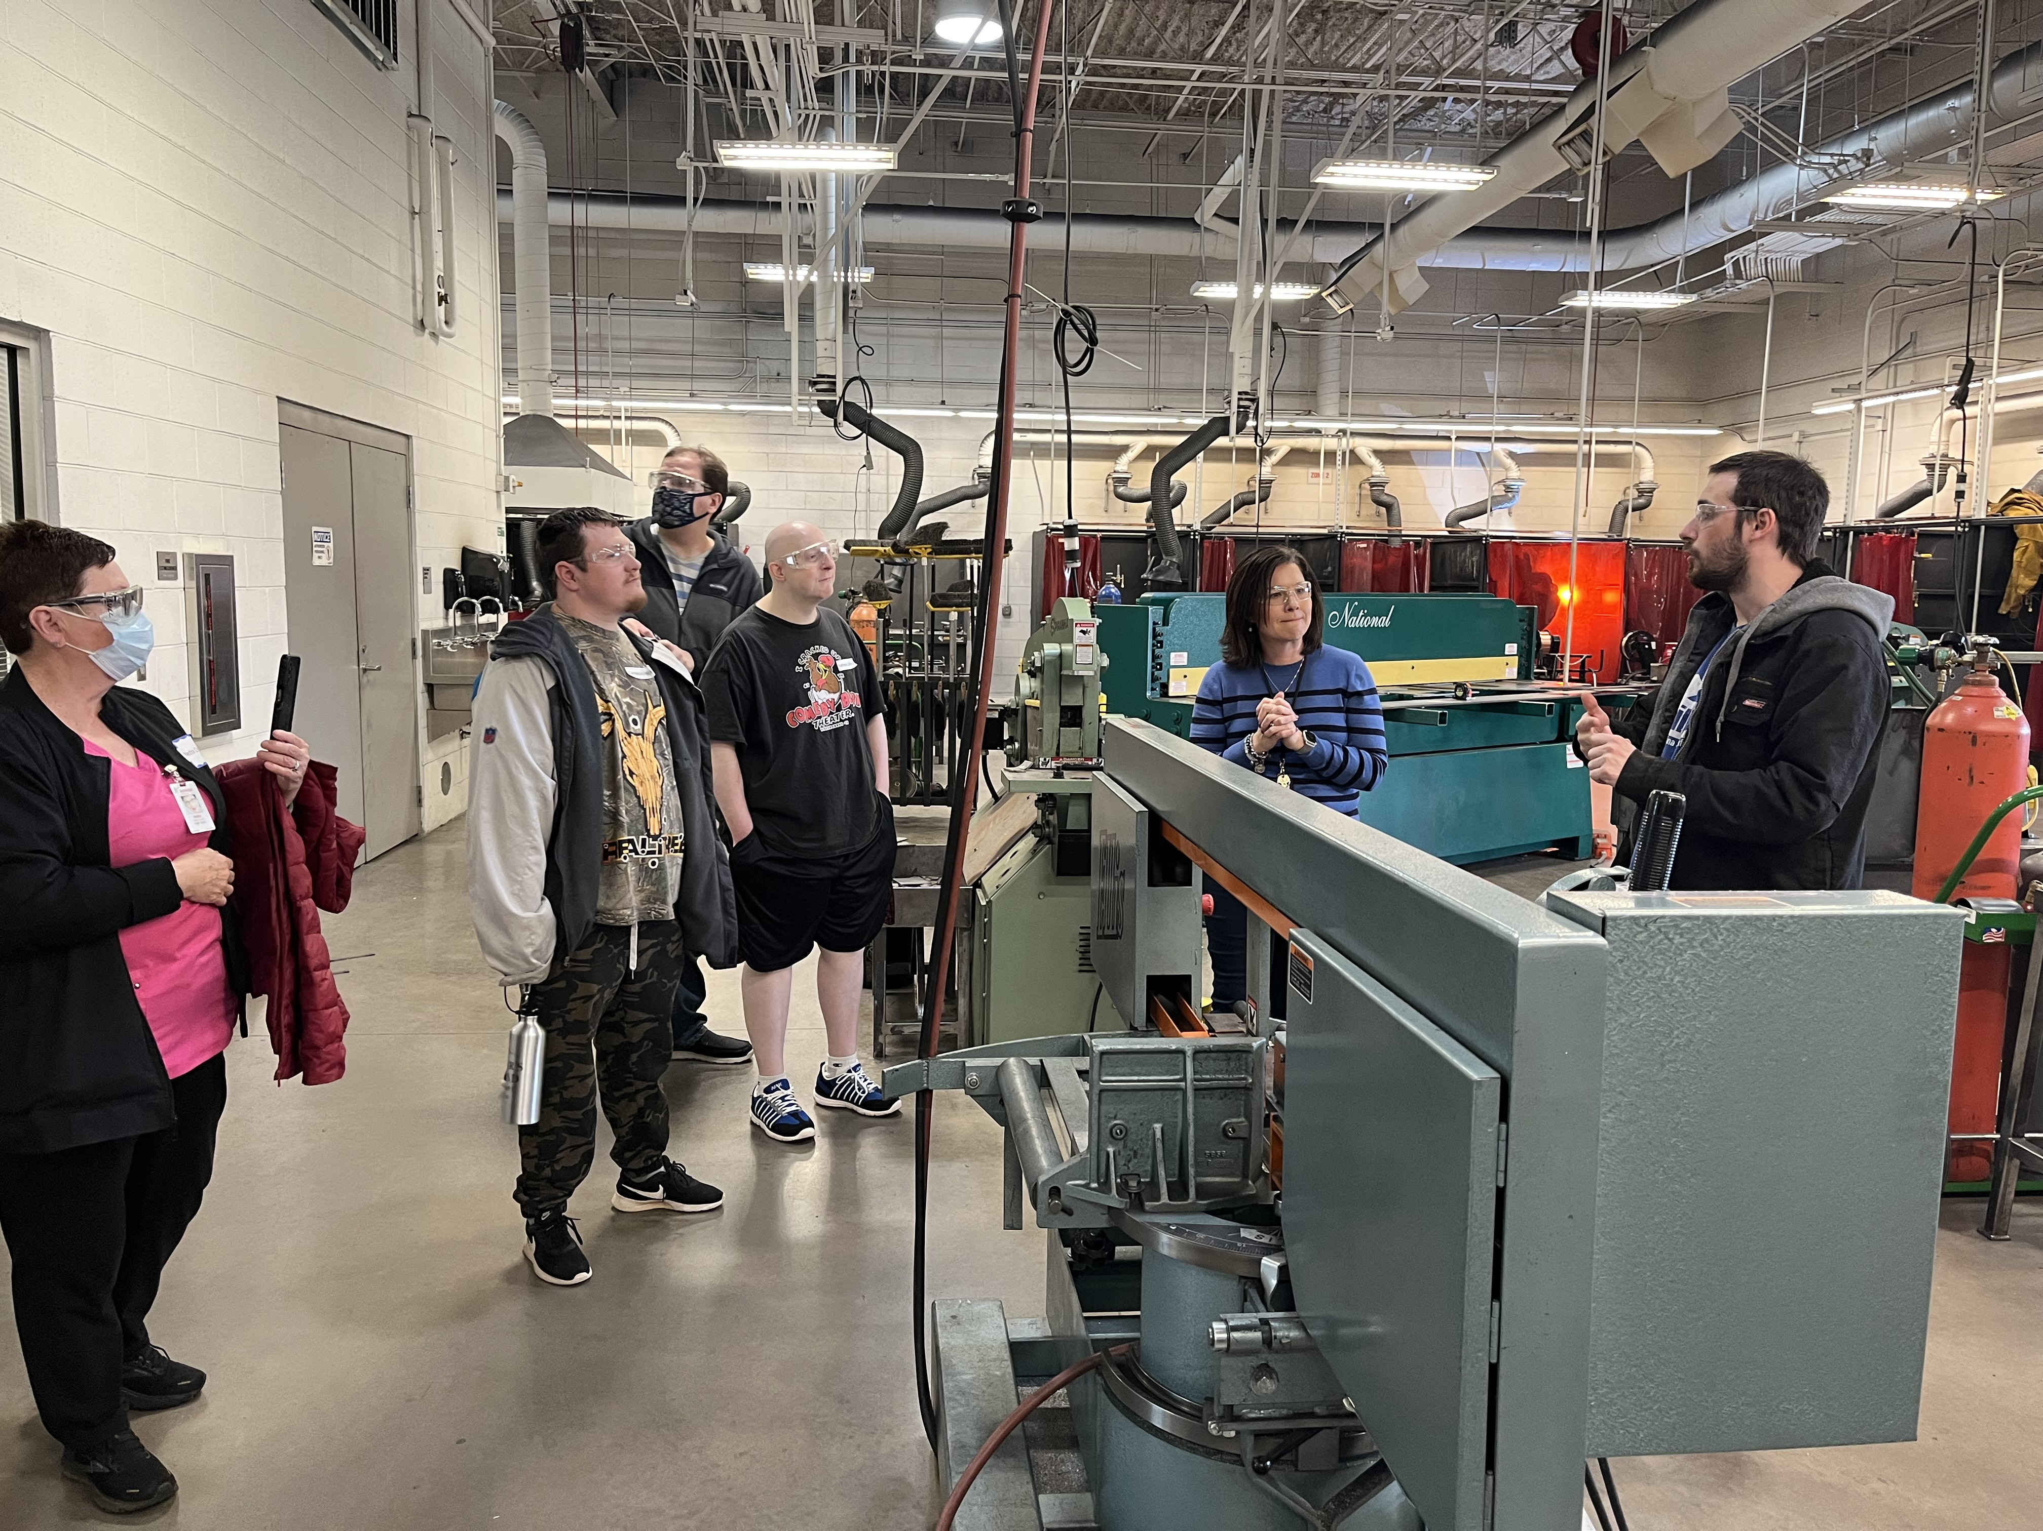
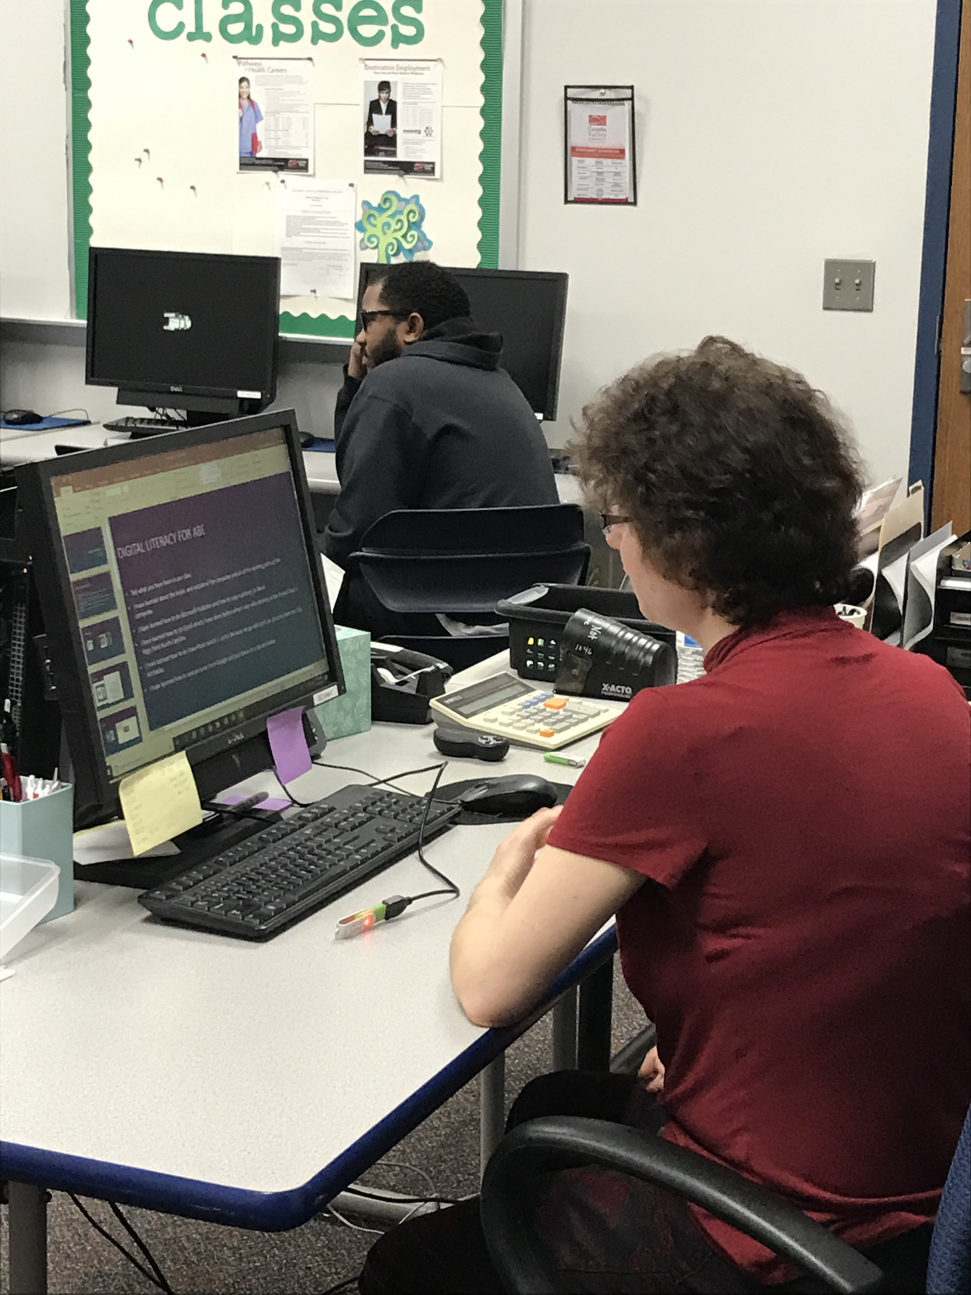
But wait, there’s more!
CVCC has organized awareness activities across both campuses in recognition of Developmental Disabilities Awareness Month.
ABE Academy students are being recognized across both campuses and have been given multiple opportunities to explore different programs throughout.
Students have been invited to enroll in the Construction Academy in Summer, 2023.

Slide 18
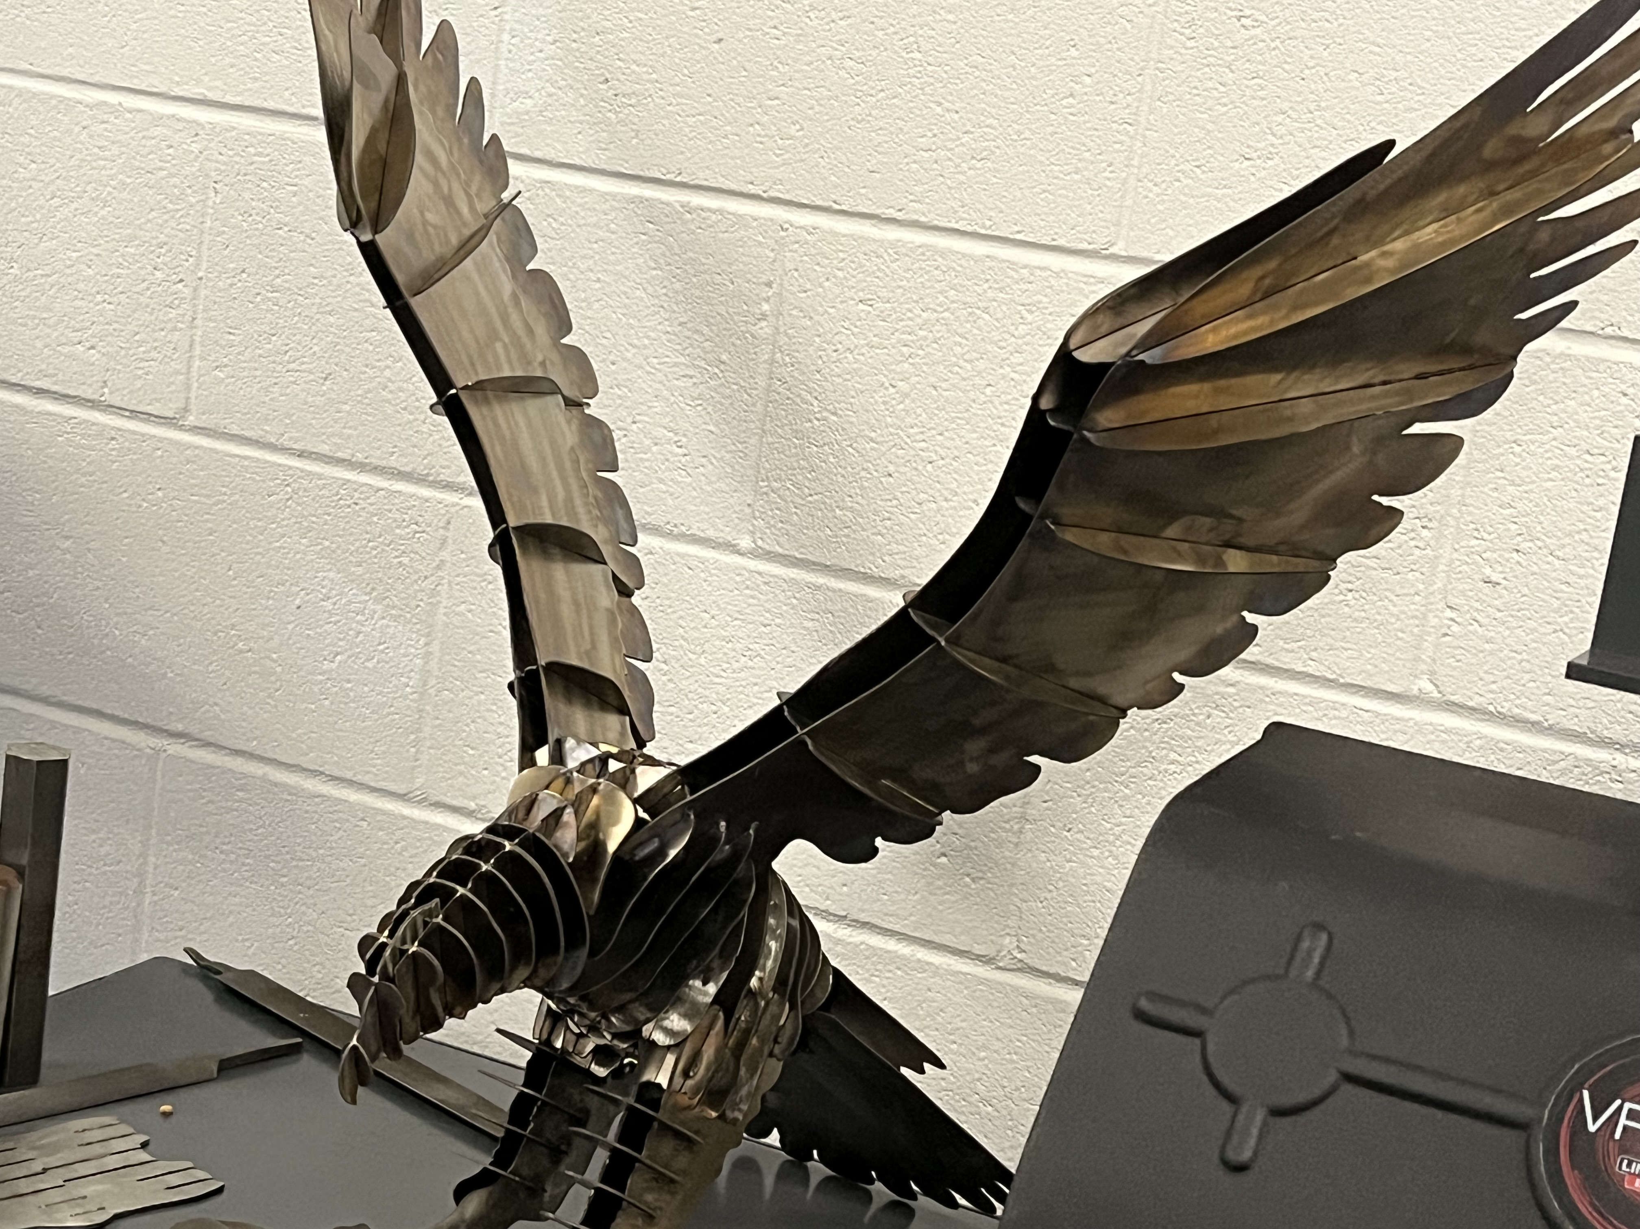
May 12, 2023
For the first time EVER, ABE Academy students, wearing caps and gowns, will walk across the stage with their neurotypical peers in the Catawba Valley Community College commencement ceremony!

Slide 19
Committment
Our implementation team is committed to continue working toward total inclusivity of our IDD students at Catawba Valley Community College beyond the pilot project timeframe. We have come a long way but there is much more work to do!
This Photo by Unknown Author is licensed under CC BY-NC

Slide 20
Any Questions?

